Slide 1

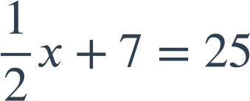
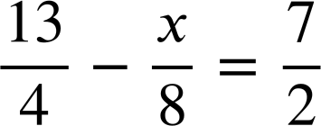
Solving two step linear equations
Task A: Solving using an additive step first
1) Manipulate the balance scale to solve the equation:
3x − 10 | = | 2
2) Solve the following equations:
9x + 7 | = | 25
b)
9x − 7 | = | 25
a)
4 | = | 5y + 19
c)
d)
Task B: Multiple approaches to solving the same equation
1) Solve these equations two different ways.
a)
2x + 18 | = | 30
3d − 27 | = | 9
35 − 7x | = | 21
b)
c)
2x + 18 | = | 30
3d − 27 | = | 9
35 − 7x | = | 21
2) Solve:
Mathematics in Education and Industry.

